Slide 1


Slide 2
Course Layout
- lecture 1 :Introduction to the Course
- lecture 2 :Data Binding
- lecture 3 :Directives
- lecture 4 :Project
- lecture 5 :Routes
- lecture 6 :Forms
- lecture 7 :Project
- lecture 8 :HttpClint
- lecture 9 :Animations
- lecture 10:Linting Testing Deploying

Slide 3
Vue.js - lecture 1 :Introduction to the Course
Client/Server Architecture
JavaScript Quick review
JSON
Git
What is Vue.js
Environment Setup
Vue.js reference

Slide 4
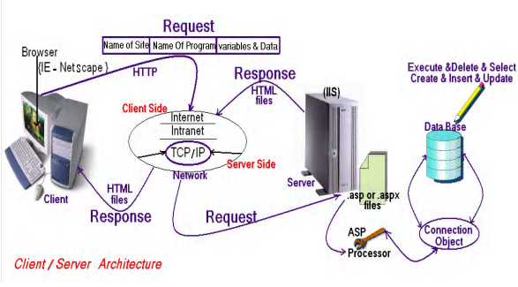
Client/Server Architecture

Slide 5
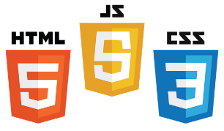

Core Components of Web Applications
UI (Front End (DOM, Framework))
Request Layer (Web API)
Back End (Database, Logic)
Server
Client
API
Front End
Database
Browser
Internet
Logic
JSON
Media Cache

Slide 6
Web programming language
Web programming language
Server Side
Java Script
client side
PHP
HTML
CSS
Angular
Vue
React
Python
Laravel
symfony
Flask
django
ASP.Net
.NetCore
MVC
Web Forms

Slide 7
Course PreRequisite
Necessary Requirements
HTML
CSS
JS
Preferred Requirements
TS

Slide 8
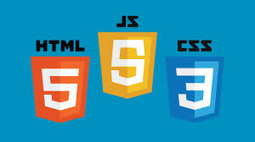
client side

Slide 9

client side Cross-platform
client side Cross-platform

Slide 10

client side Cross-platform
client side Cross-platform

Slide 11

HTML Hyper Text Markup Language

Slide 12
HTML Hyper Text Markup Language
What is HTML?
HTML is a language for describing web pages.
HTML stands for Hyper Text Markup Language
HTML is a markup language
A markup language is a set of markup tags
The tags describe document content
HTML documents contain HTML tags and plain text
HTML documents are also called web pages

Slide 13
HTML Versions
Version | Year
HTML | 1991
HTML+ | 1993
HTML 2.0 | 1995
HTML 3.2 | 1997
HTML 4.01 | 1999
XHTML 1.0 | 2000
HTML5 | 2012
XHTML5 | 2013

Slide 14
CSS : Cascading Style Sheets
What is CSS?
CSS stands for Cascading Style Sheets
Styles define how to display HTML , XML elements
Styles were added to HTML 4.0 to solve a problem
Combined with JavaScript and VBScript
Separate format and content
External Style Sheets can save a lot of work

Slide 15

DOM (Document Object Model)
Document Object Model makes every addressable item in a web application an Object that can be manipulated for color, transparency, position, sound and behaviors.
Every HTML Tag is a DOM object
CSS
DOM
JavaScript
HTML

Slide 16
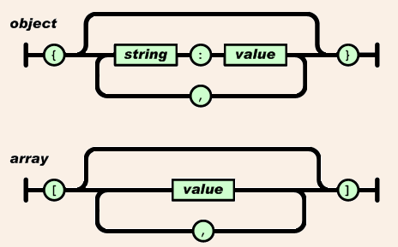
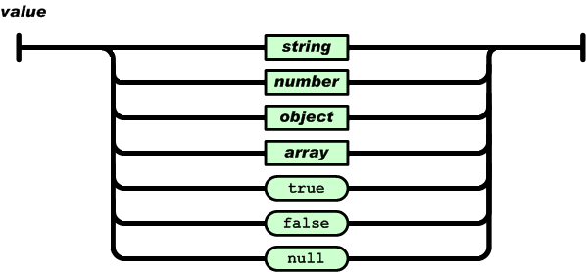
JSON (JavaScript Object Notation)

Slide 17
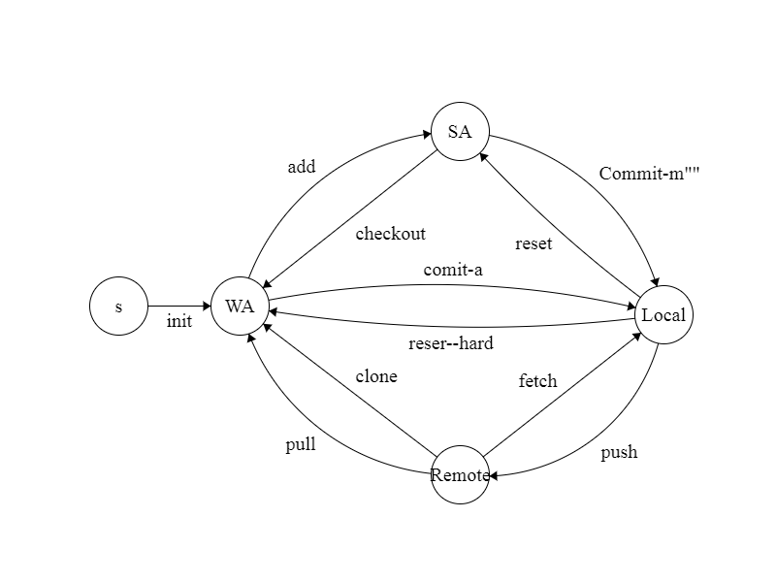
Git distributed version control system

Slide 18

best JS frameworks available in the markets for web application development.
AngularJS.
React.
Ember.js.
Vue.js.
Backbone.js.
Mithril.js.
Polymer.js.
Node.js.

Slide 19
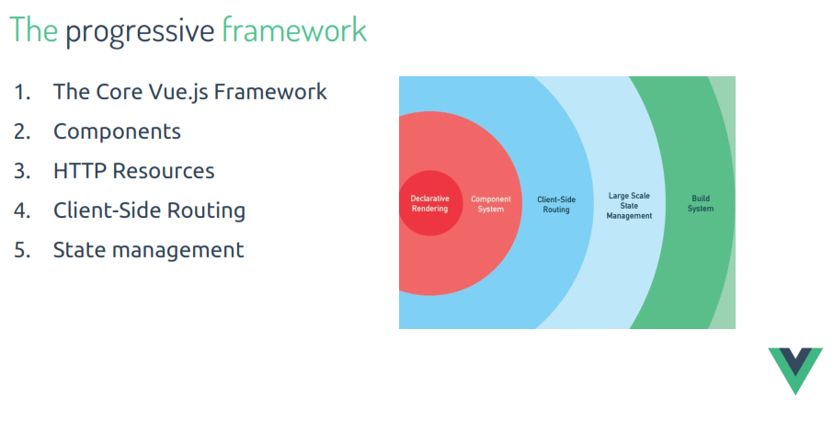
Why Vue

Slide 20
Features
Lightweight
Reusable Components
Directives
Event Handling
Routing

Slide 21
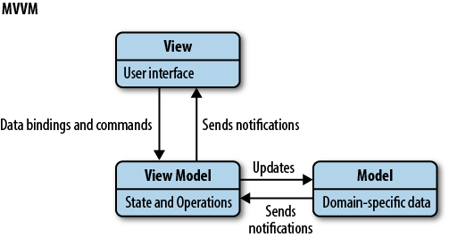
Vue Course layout
Vue is MVVM pattern

Slide 22
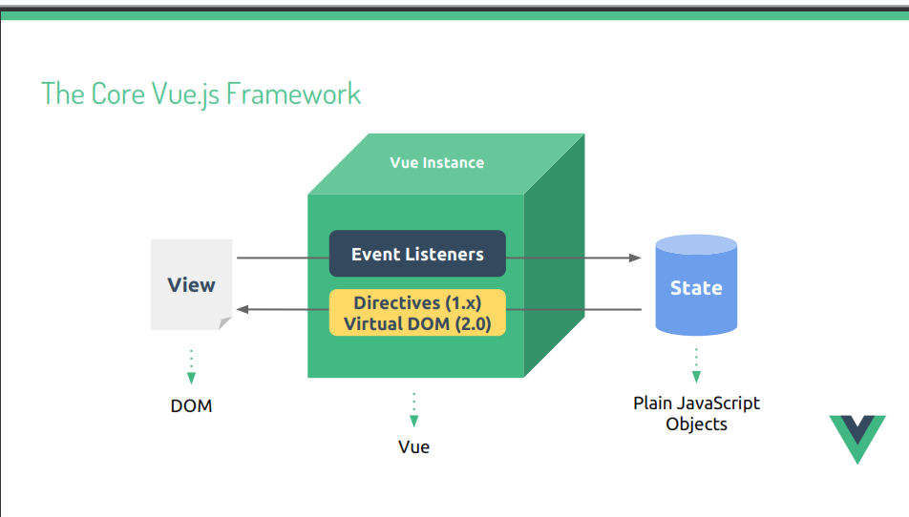
Vue Course layout

Slide 23
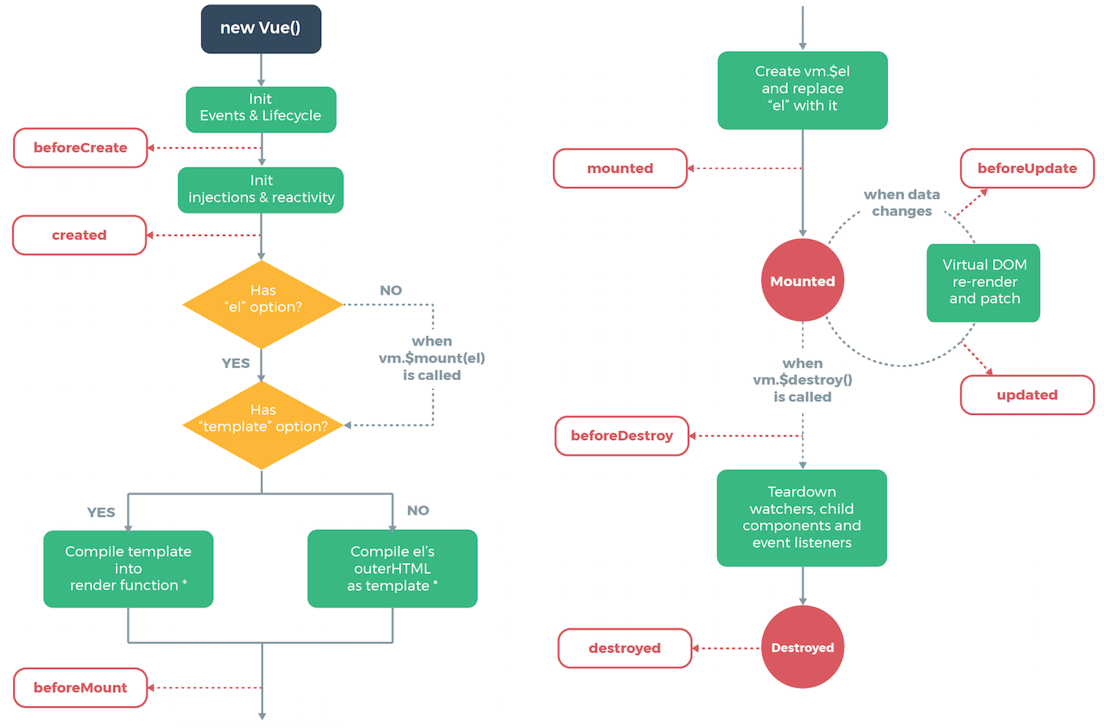
Architecture

Slide 24



Environment Setup
Required Programs
Browser
Optional Programs
VScode IDE Setup
GitHub Version Control
vue devtools

Slide 25

Environment Setup
Node.js Setup
https://nodejs.org/en/

Slide 26
Environment Setup
visual studio code IDE Setup
https://code.visualstudio.com/

Slide 27
Environment Setup
visual studio code IDE extensions
Vue VS Code Extension Pack
https://code.visualstudio.com/

Slide 28
Project Setup
npm install -g @vue/cli
vue create application-name
npm run serve
https://cli.vuejs.org/

Slide 29
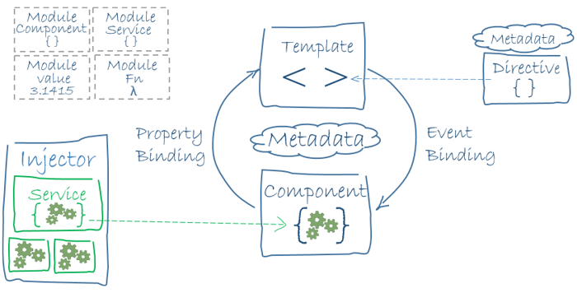
Overview

Slide 30
Vuejs reference
https://vuejs.org/v2/guide/

